Slide 1
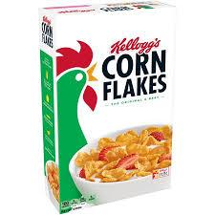
Tell cereal to buy itself!
Time taken = 1 units

